Slide 1
Project Fake Taxi
Colin Bossuyt, Xander Vyvey, Alberiek Depreytere and Esteban Desmedt
https://github.com/vives-project-xp/Fake-Taxi

Slide 2
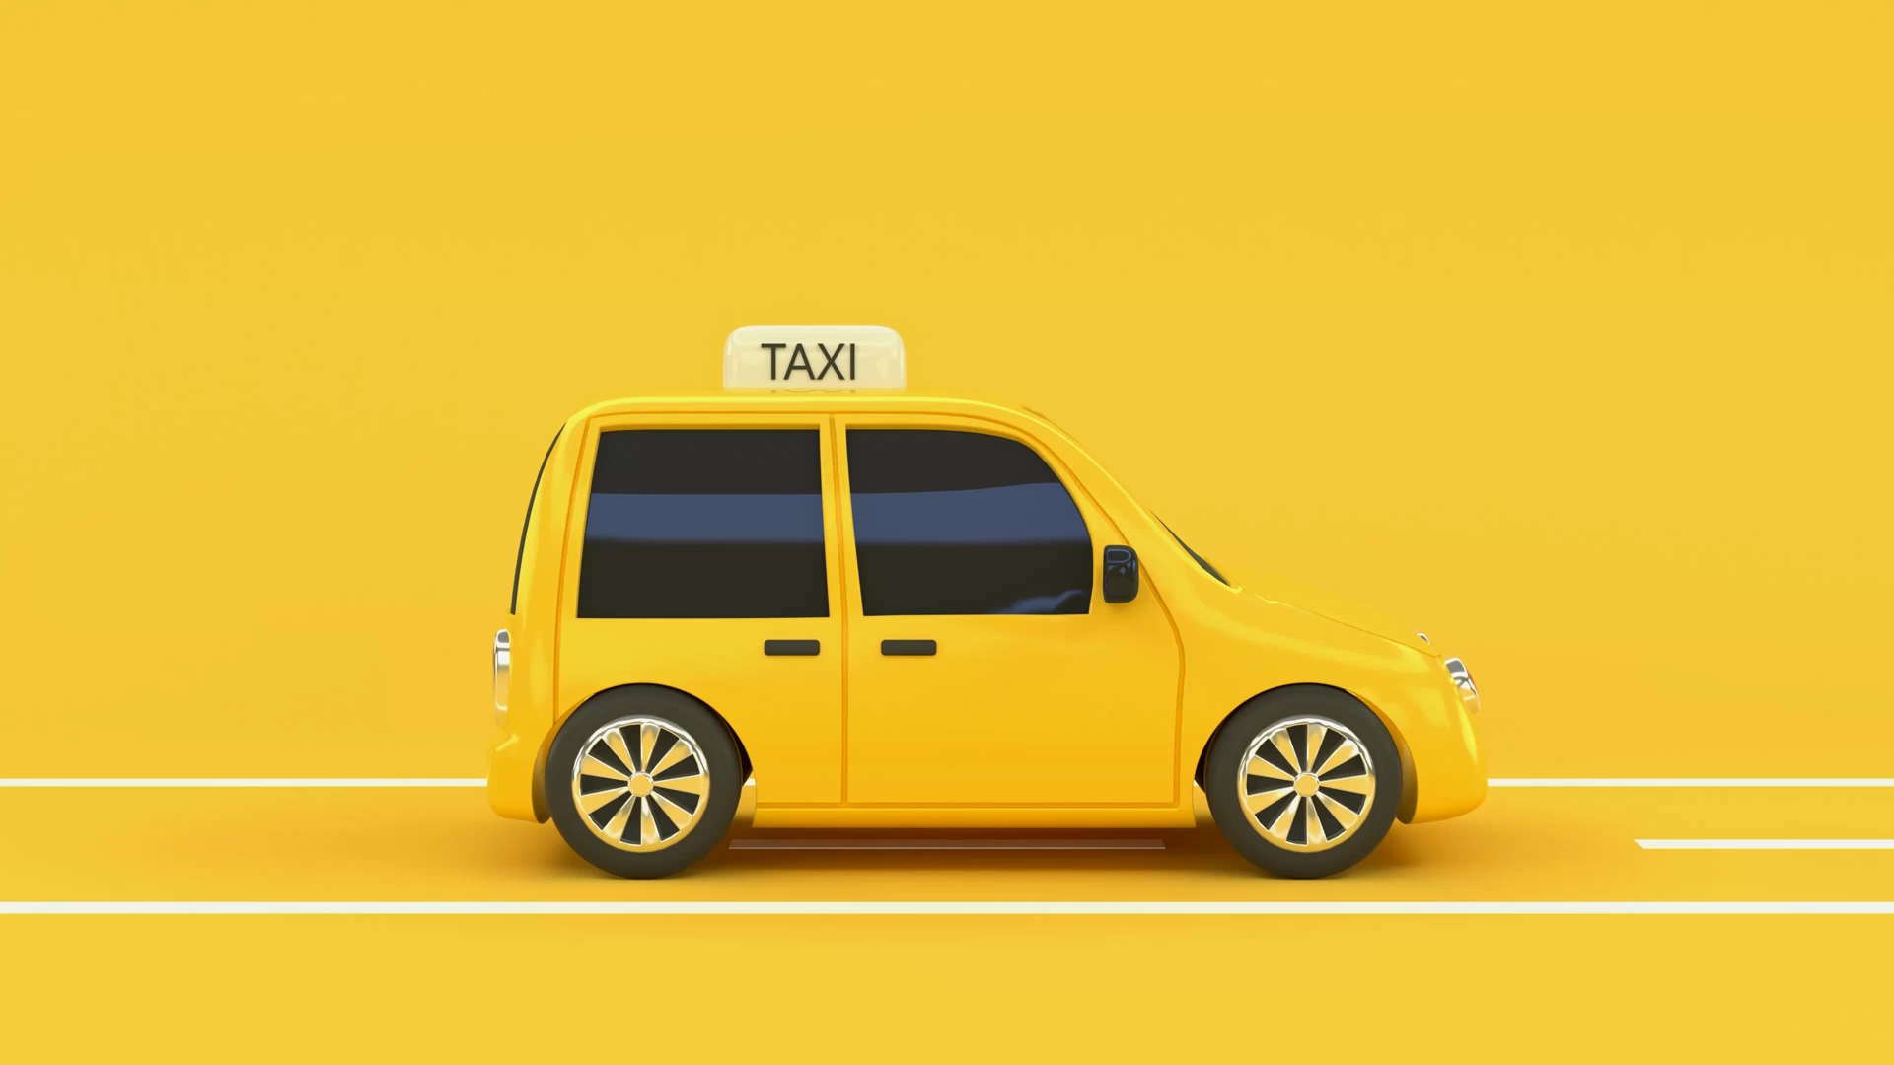
Table of contents
The role of each team member
The problem statement
The proof of concept
The prototype of the product
The planning
Some final thoughts on the project

Slide 3
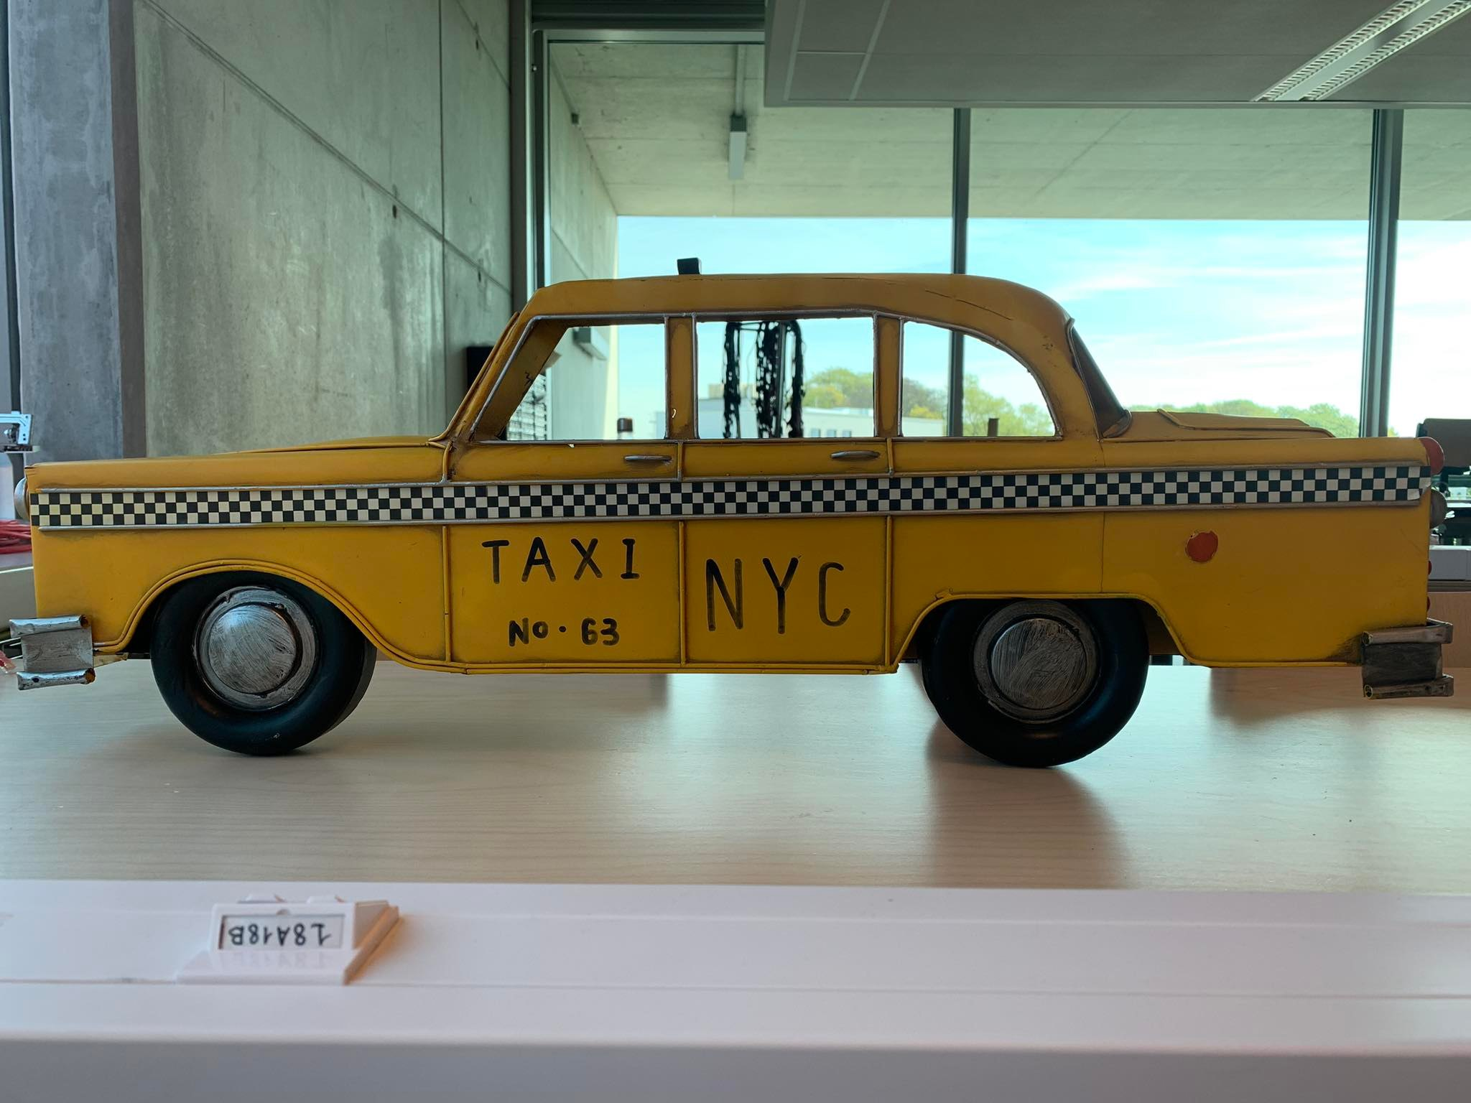
Meet our team

Slide 4
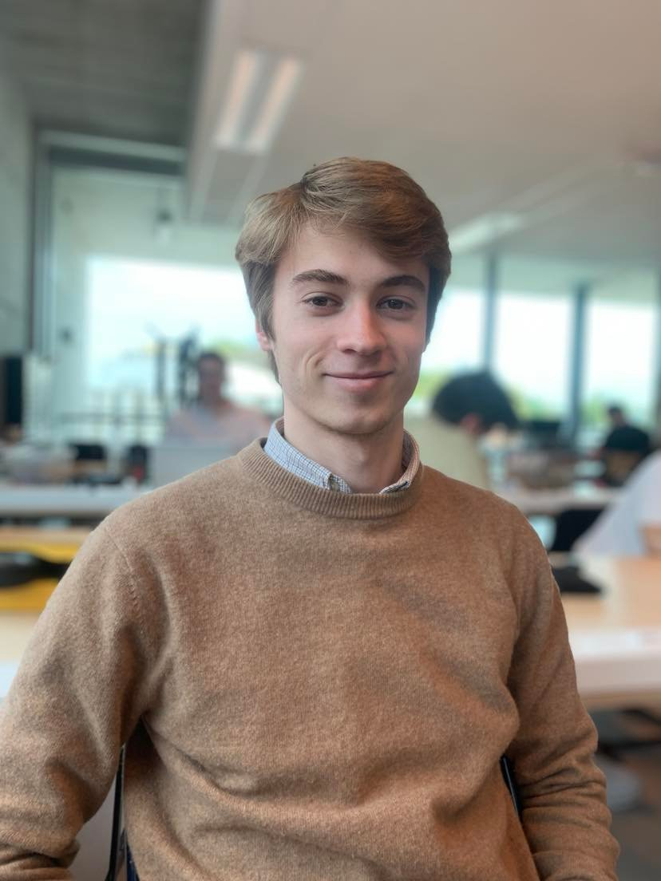
Colin Bossuyt
3D prints
Engine drive
G-code
Arduino IDE

Slide 5
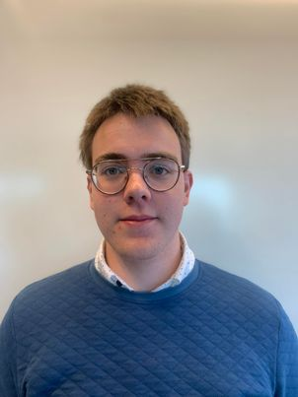
Alberiek Depreytere
Speaker
Elektronica

Slide 6
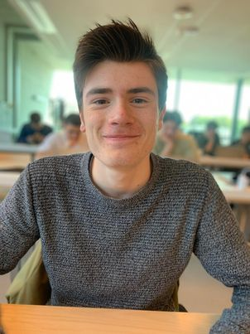
Xander Vyvey
Mechanica
Engine drive
ReadME
Prototype

Slide 7
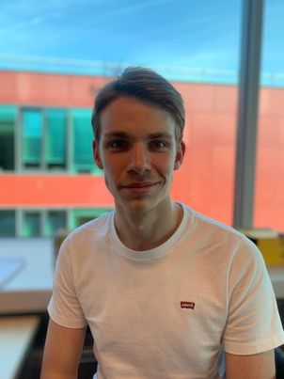
Esteban Desmedt
Software
Engine drive
Documentation
Video

Slide 8



Problem

Slide 9
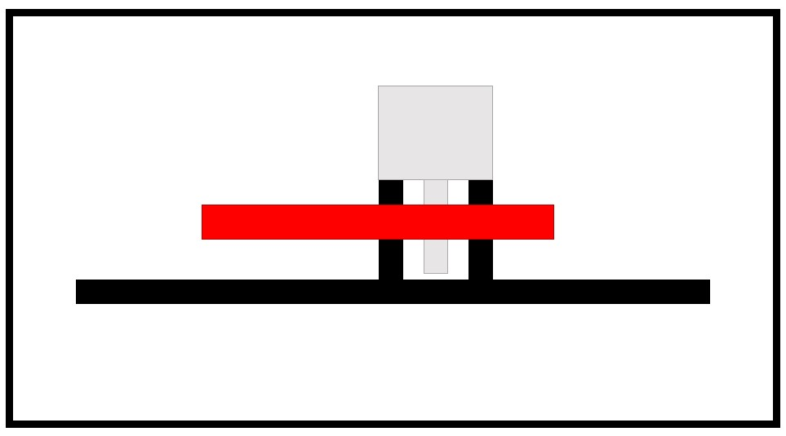
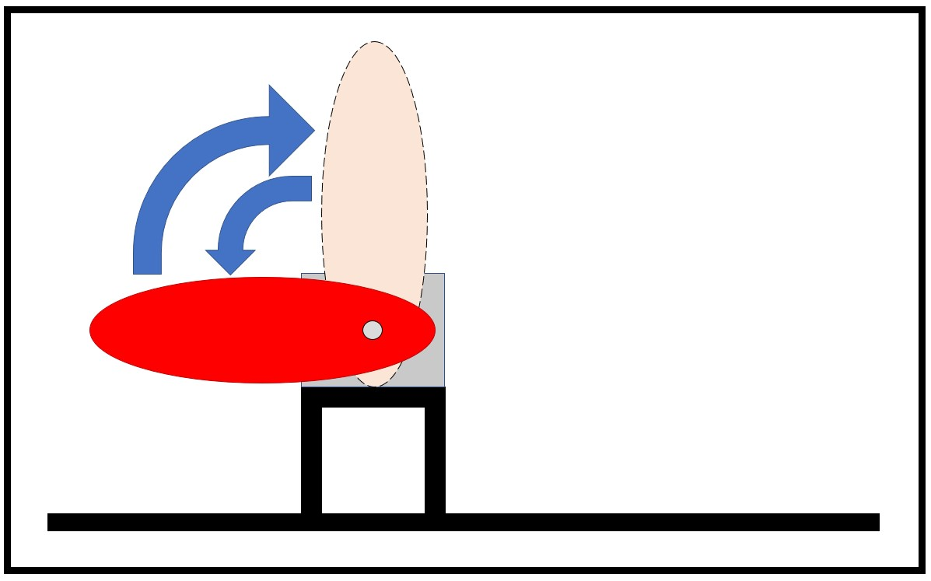
Concept

Slide 10
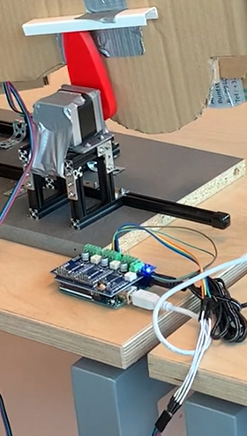
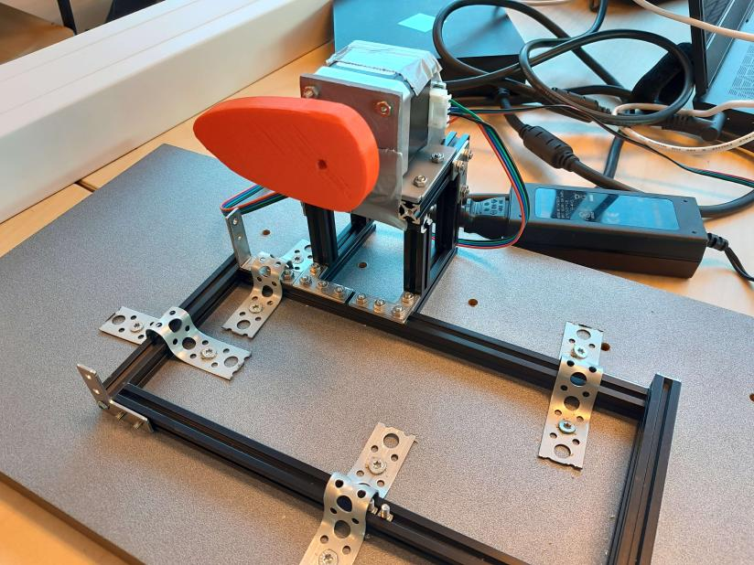
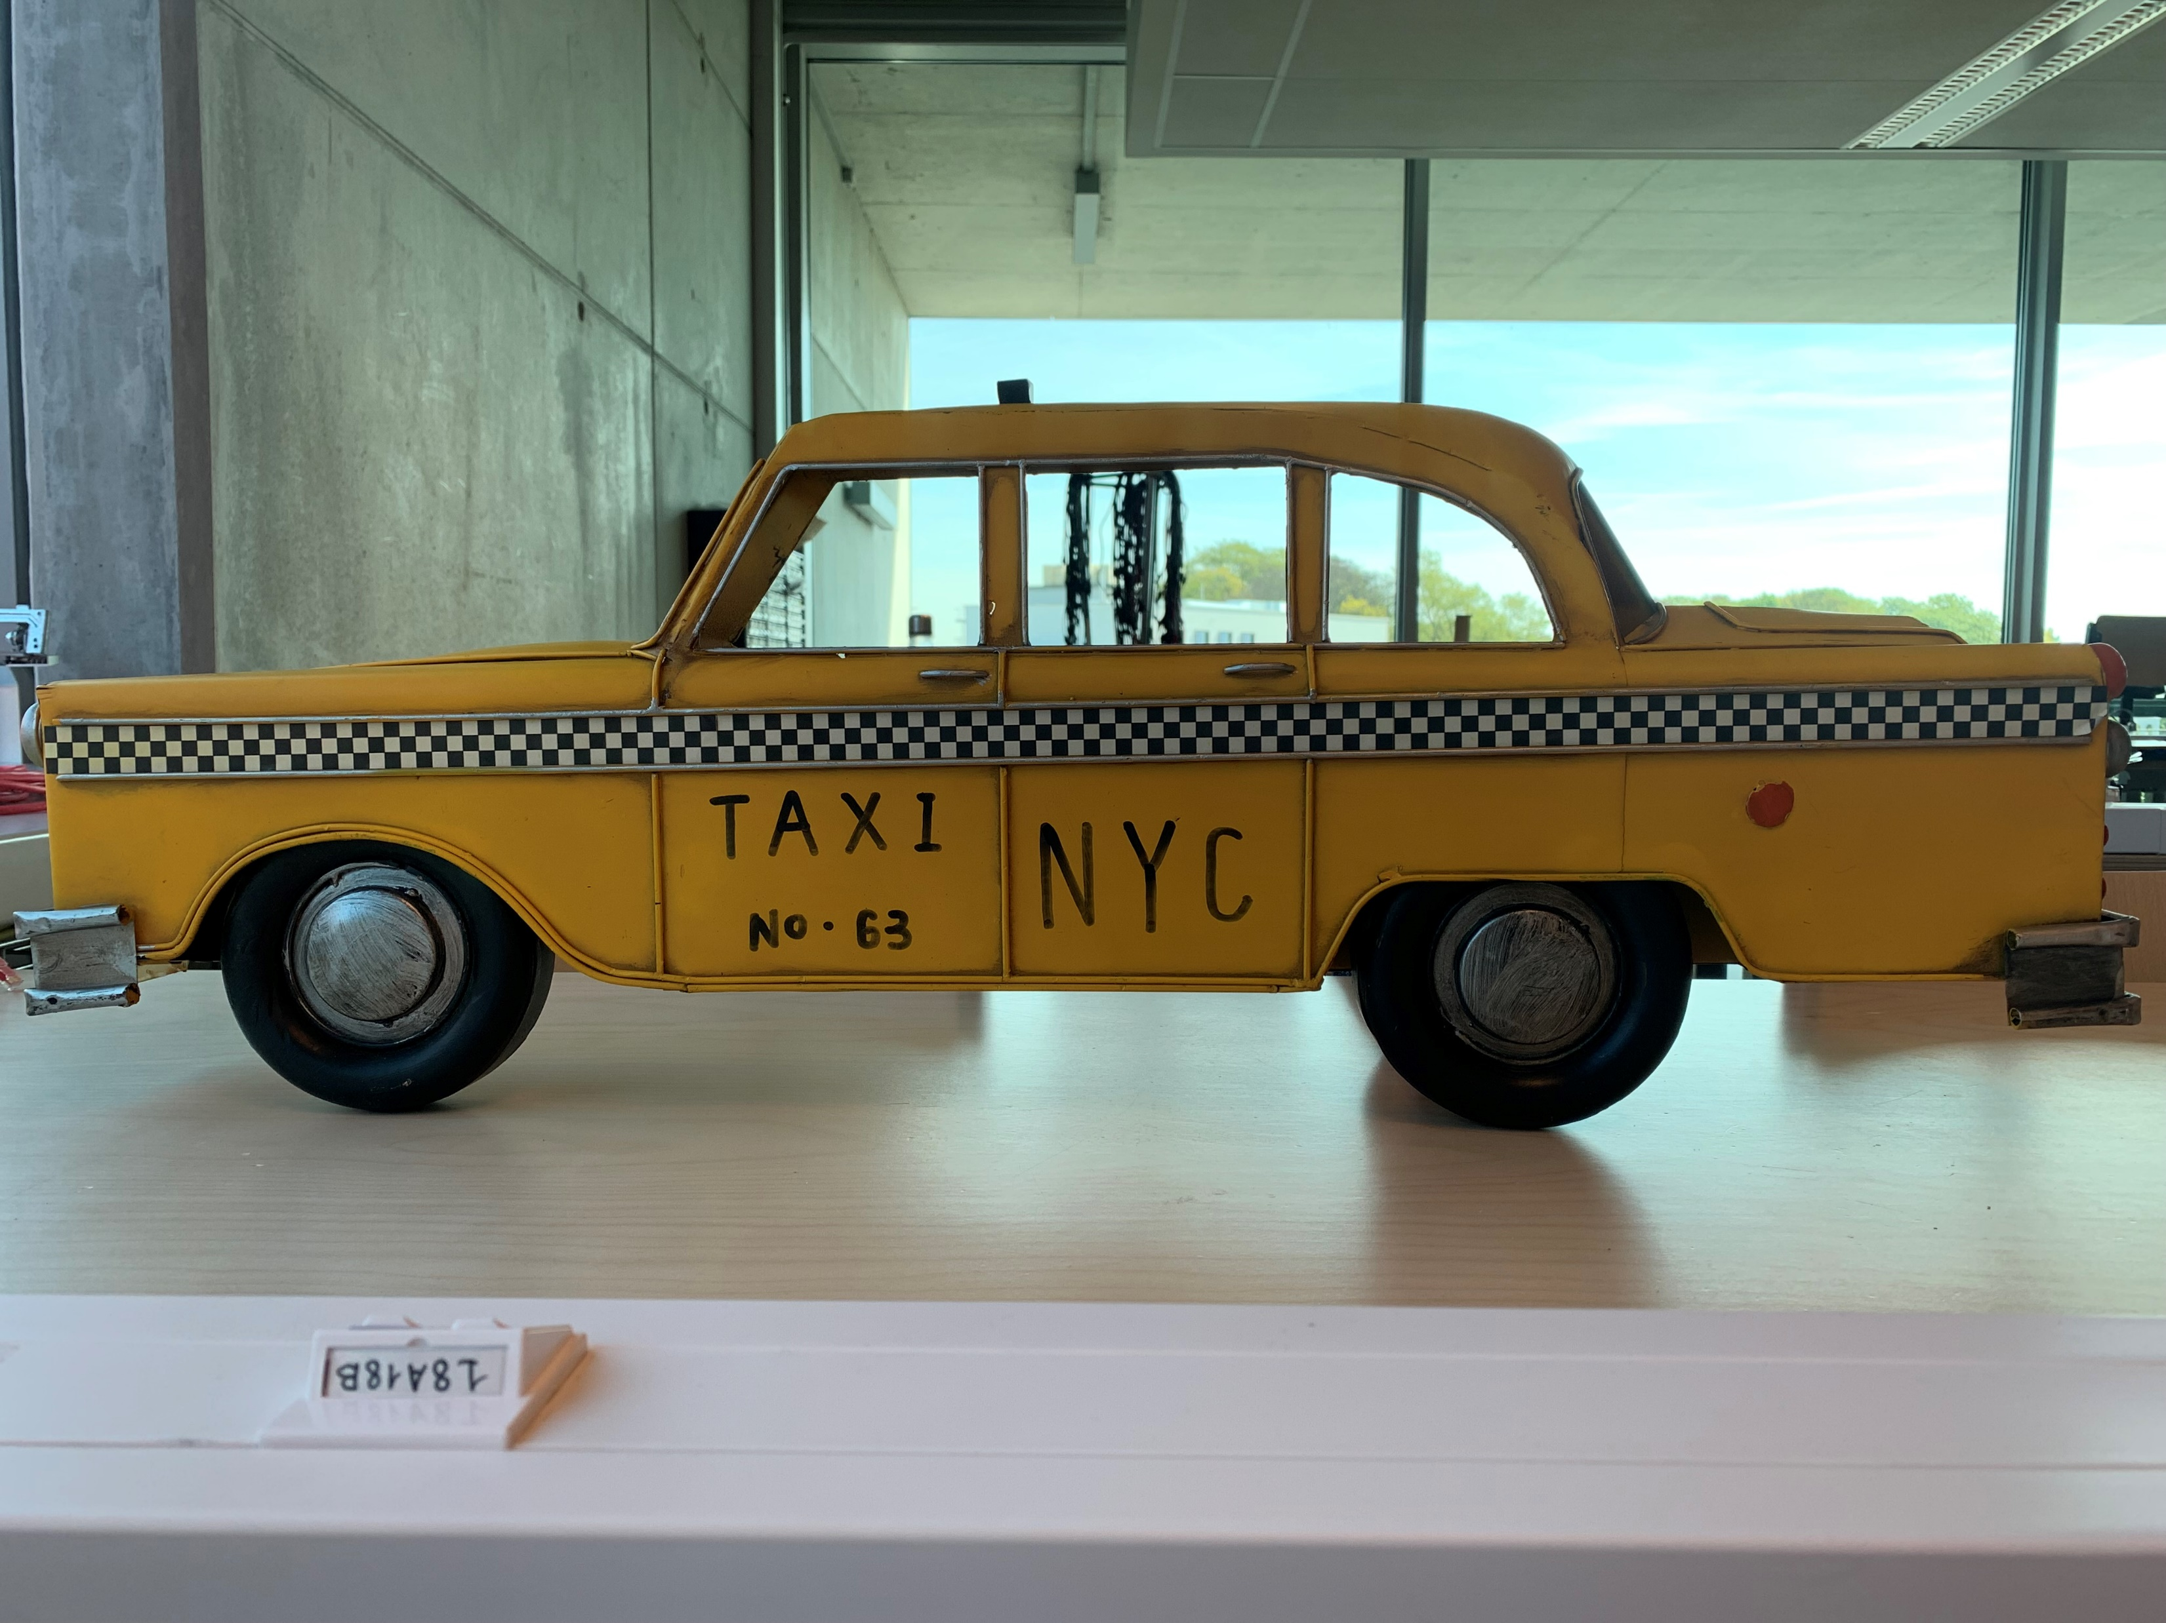
Prototype

Slide 11
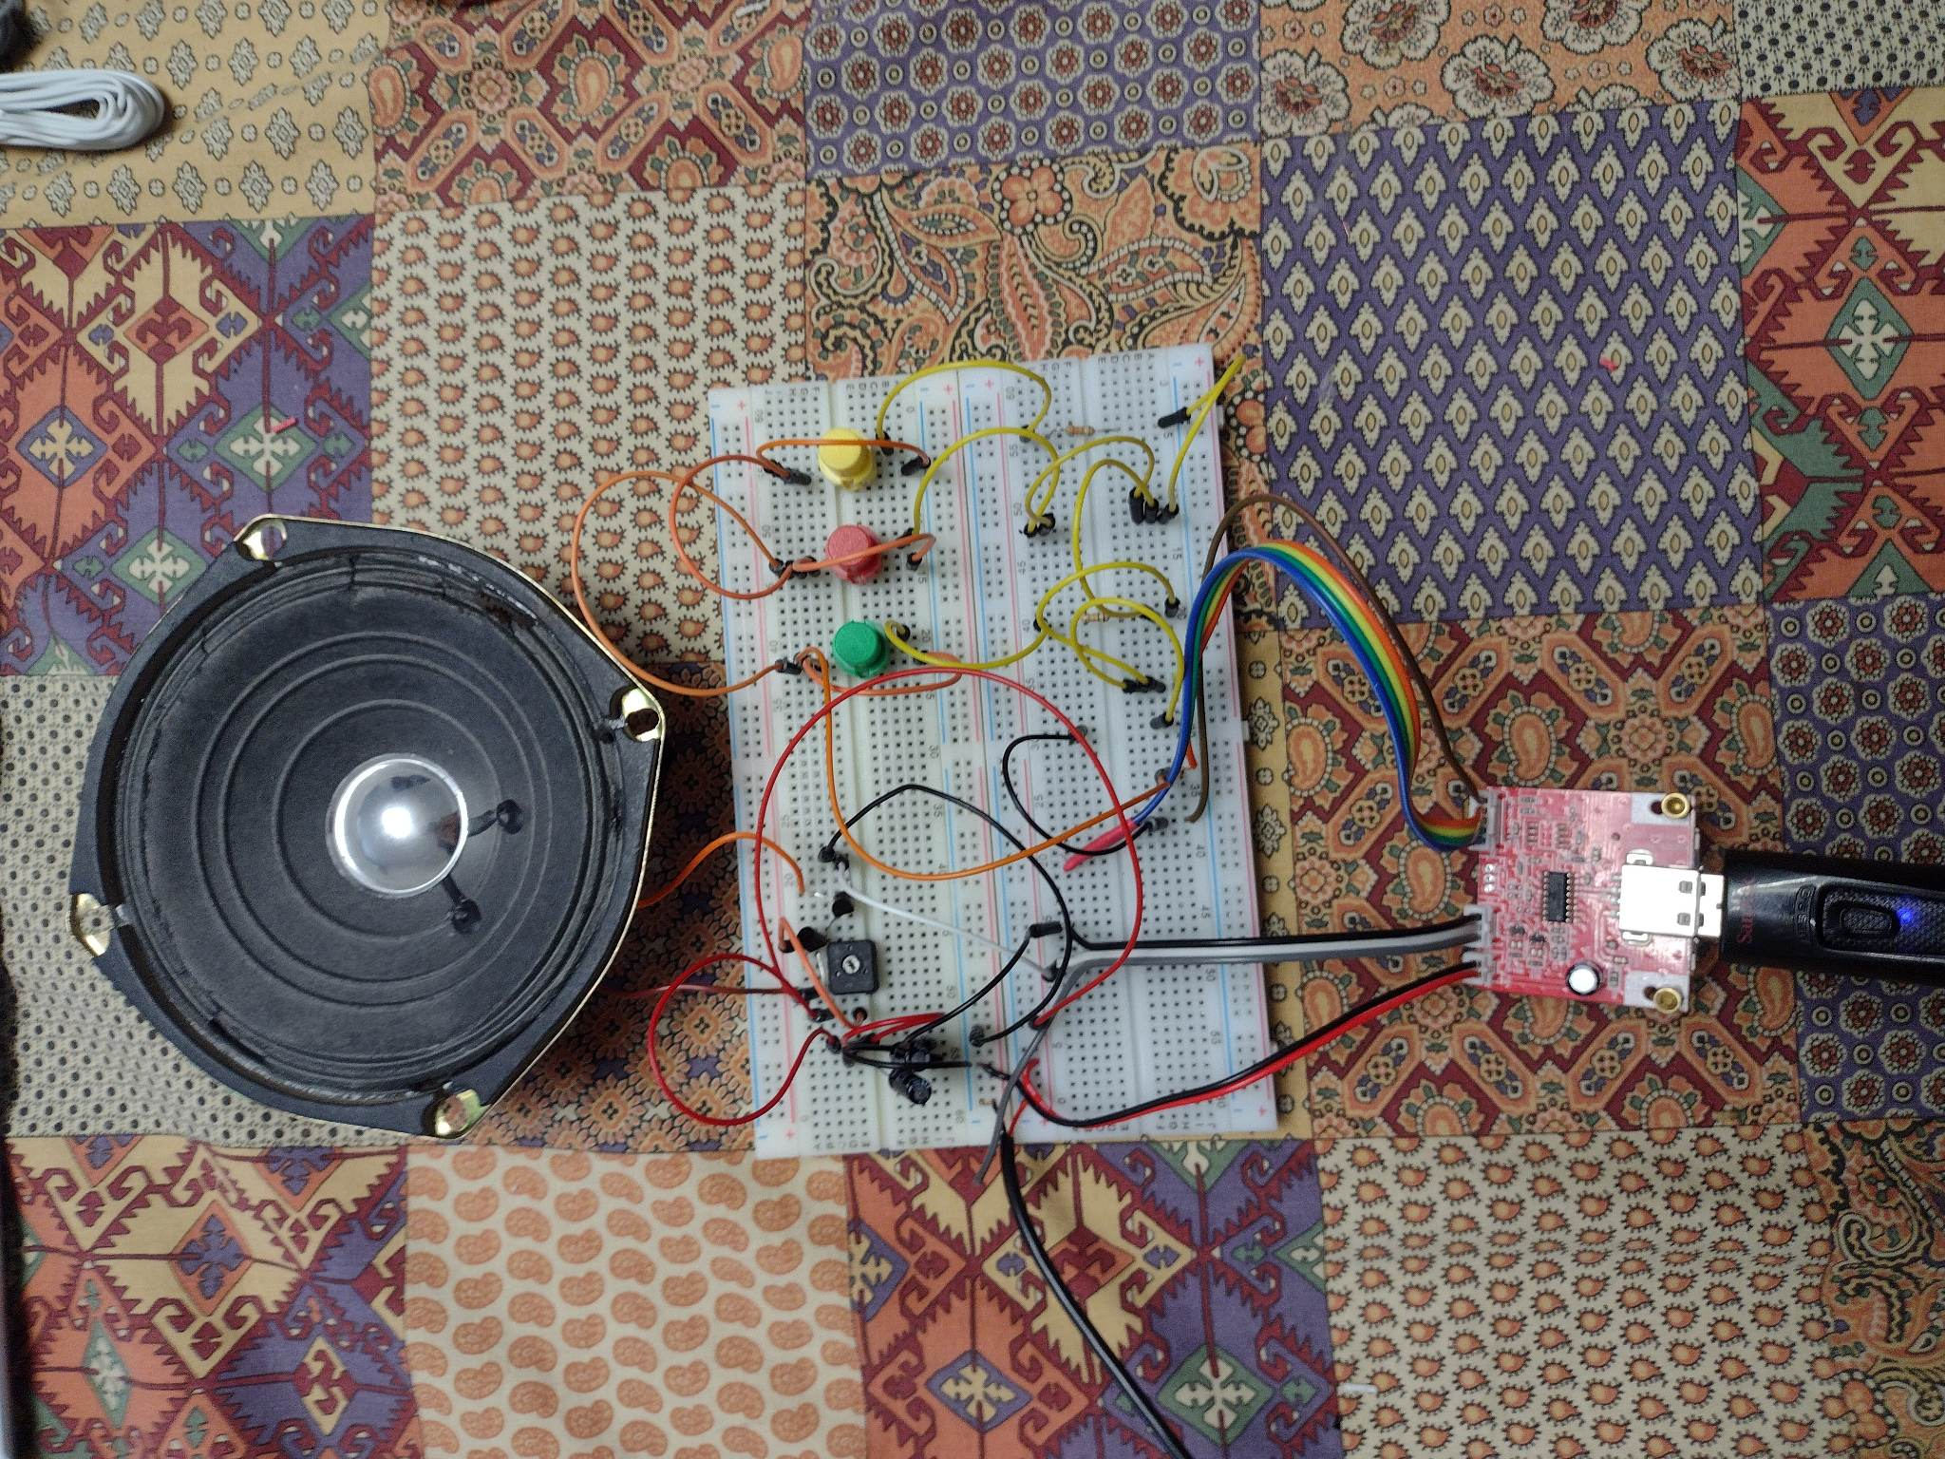
Prototype

Slide 12
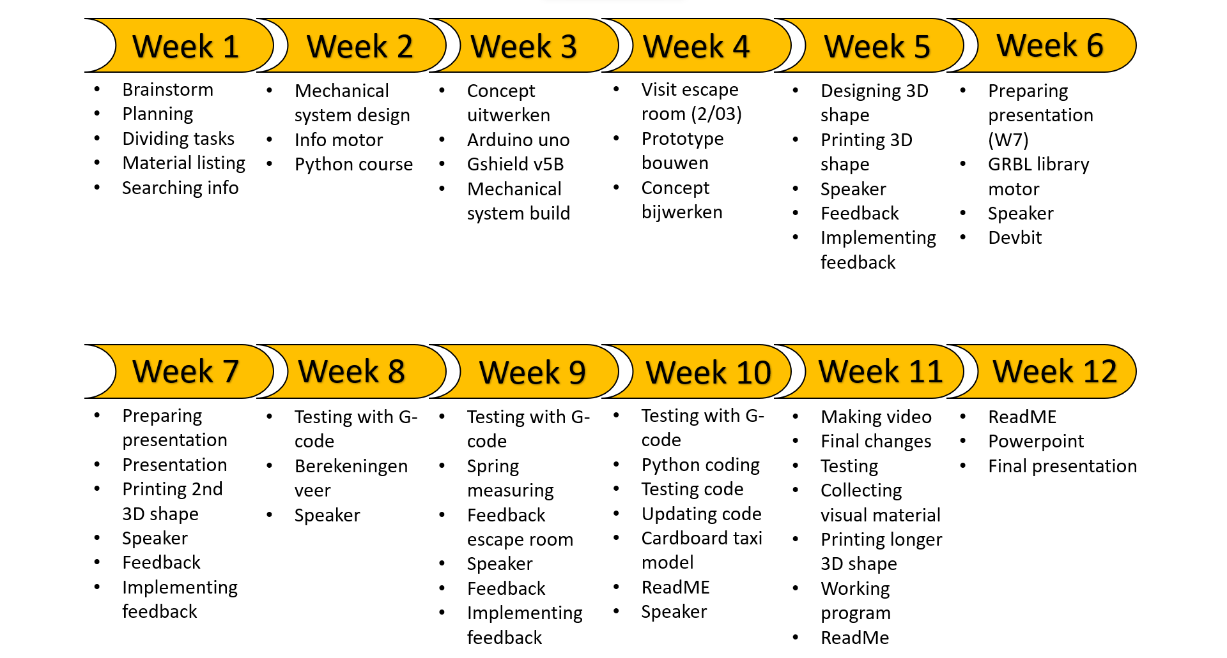
Planning

Slide 13
Final thought?

